Slide 1
WebGPU Flowing Shallow Waves
2025 Fall CIS 565 Final Project
Milestone 3 Presentation
Qirui Fu Pavel Peev
Tianhong Zhou

Slide 2
Content
Overview
Implementation in Milestone 3
Simulation Part
Rendering Part
Interaction Part
Work for next mileston

Slide 3
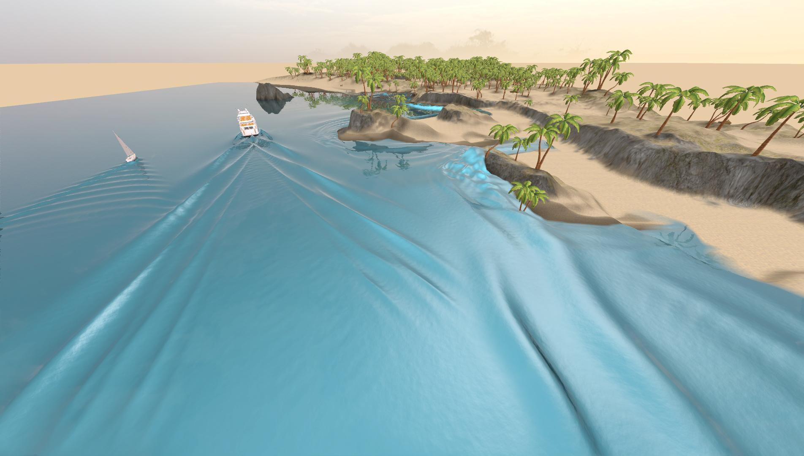
Project Overview
Reproduce Generalizing Shallow Water Simulation with Dispersive Surface Waves (SIGGRAPH 2023) model using WebGPU
Real-time, large-scale water wave propagation
Interactive control features
Generalizing Shallow Water Simulation with Dispersive Surface Waves (Stefan Jeschke and Chris Wojtan)

Slide 4
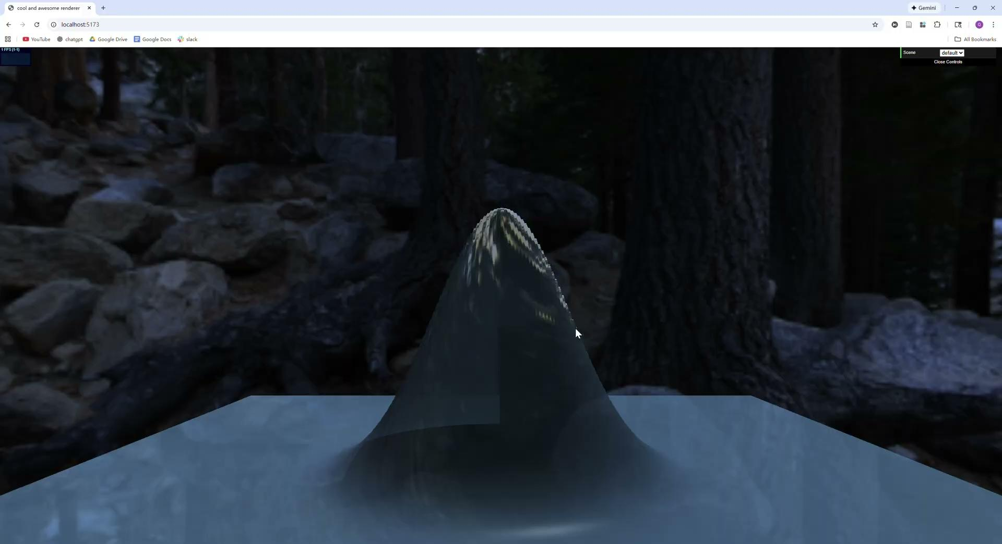
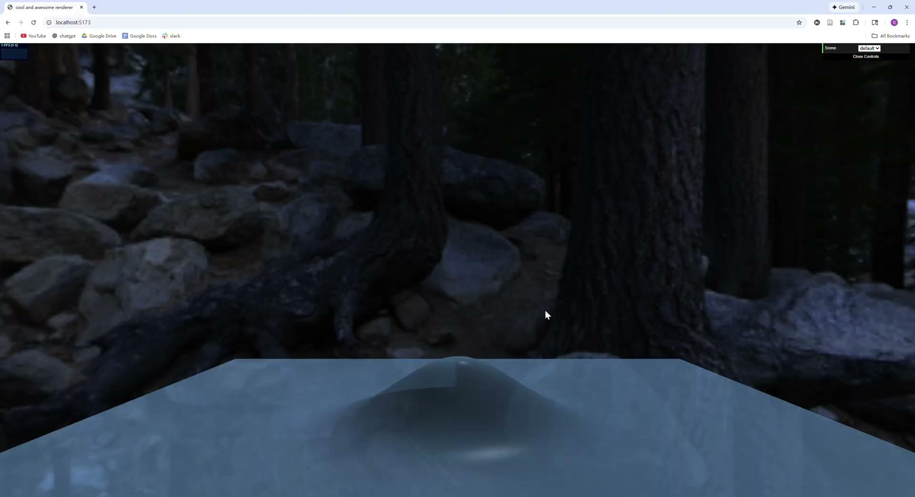
Milestone 3 - Simulation Part
Simulation Part
Fixed the bugs left in the Milestone 2

Slide 5
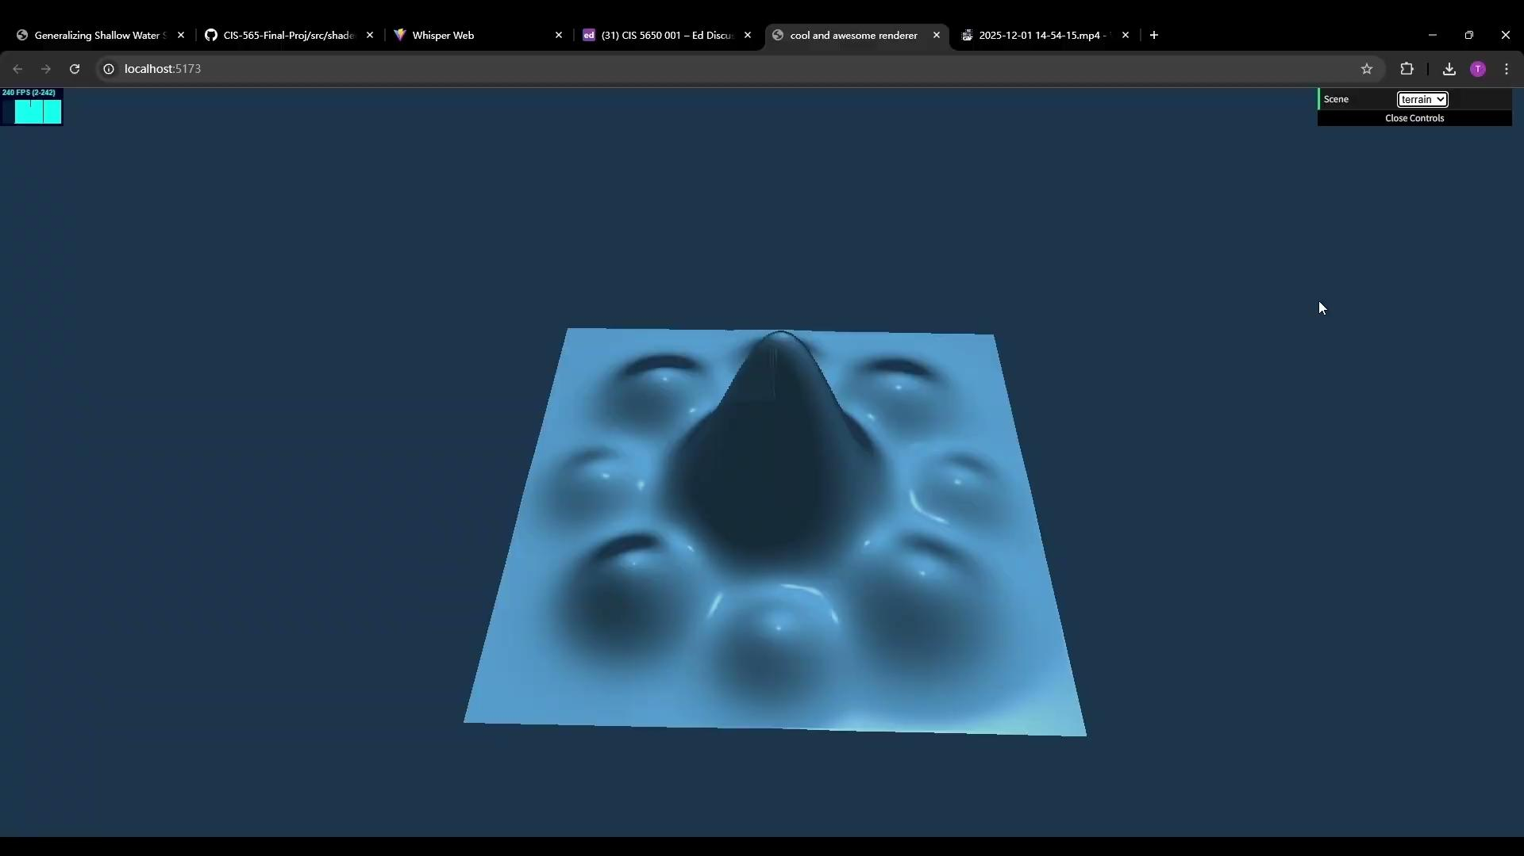
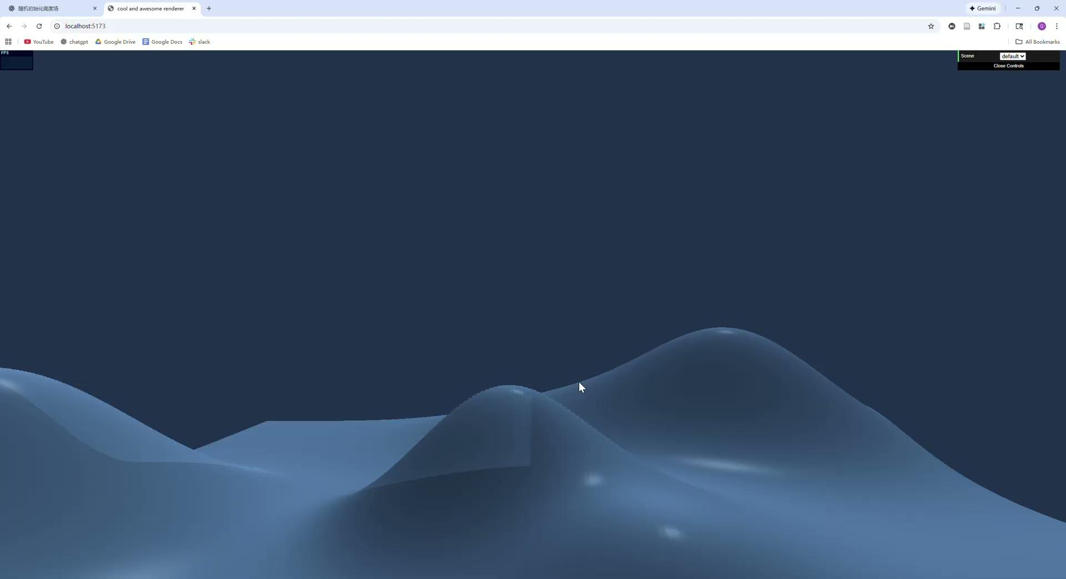
Milestone 3 - Simulation Part
Simulation Part
Fixed the bugs left in the Milestone 2

Slide 6
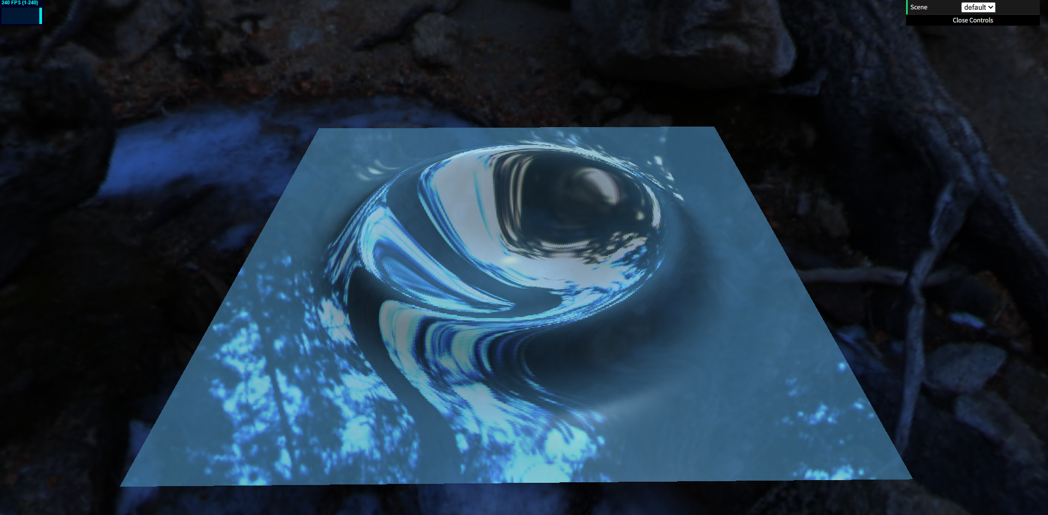
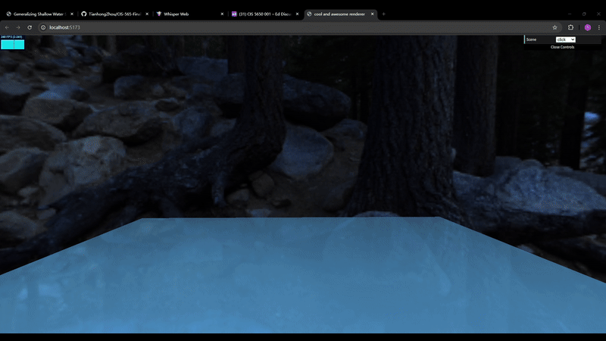
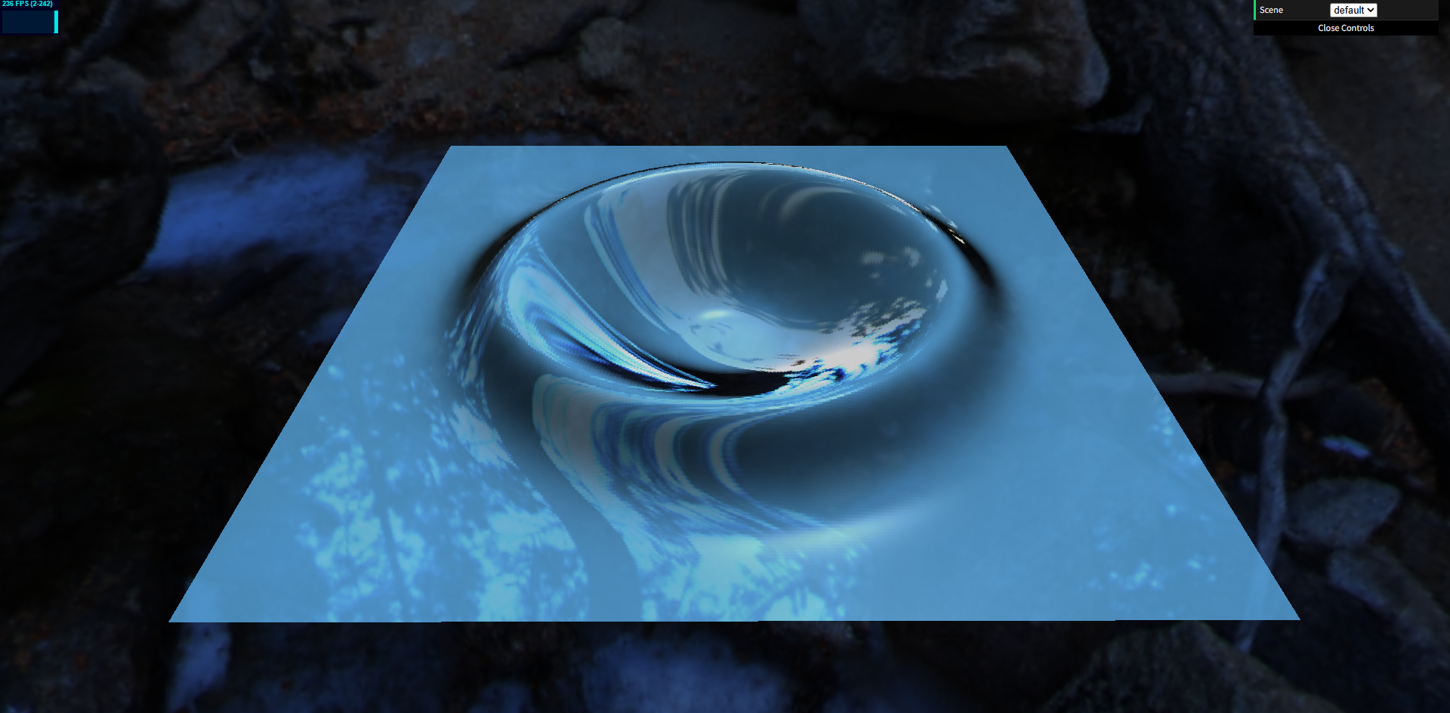
Milestone 3 - Rendering Part
Added environment mapping
Added Schlick Fresnel to blend reflection vs lighting
Original
With Fresnel
Environment mapping

Slide 7
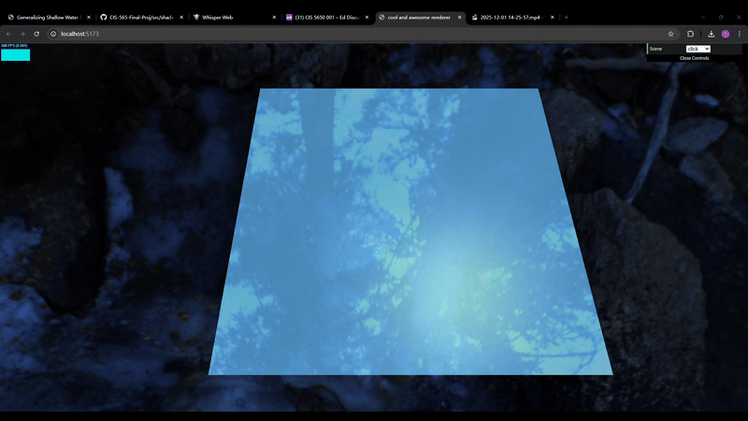
Milestone 3 - Interaction Part
Implement a basic interactive scene
Click on water surface for adding bumps

Slide 8
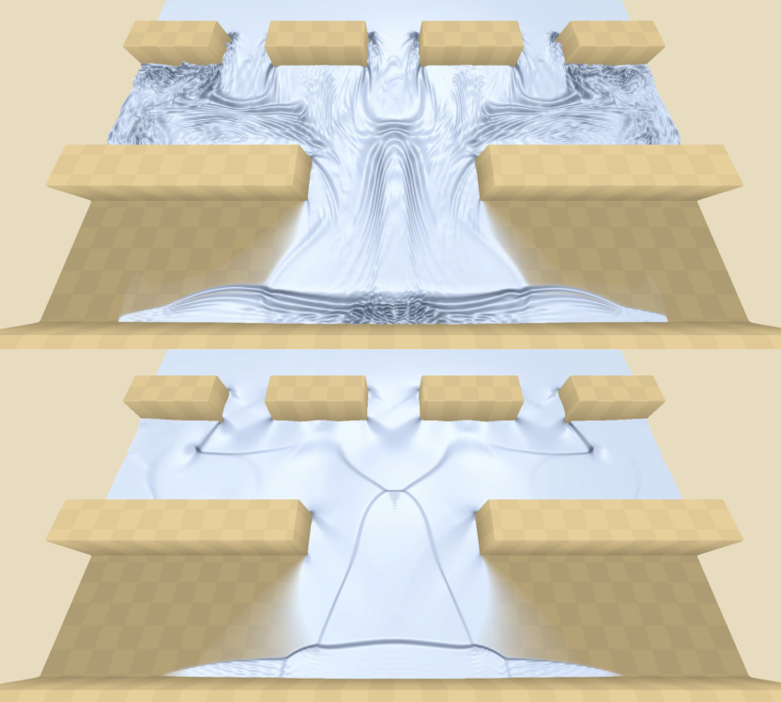
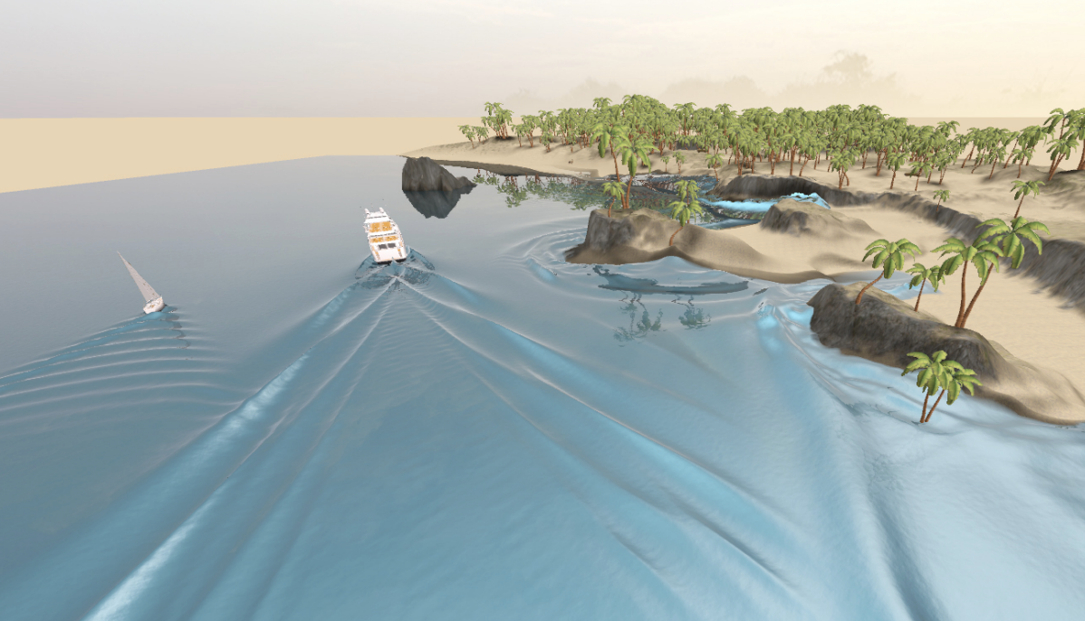
Work for future milestones
Add more scenes
Interaction with boats, terrain and boundary conditions

Slide 9
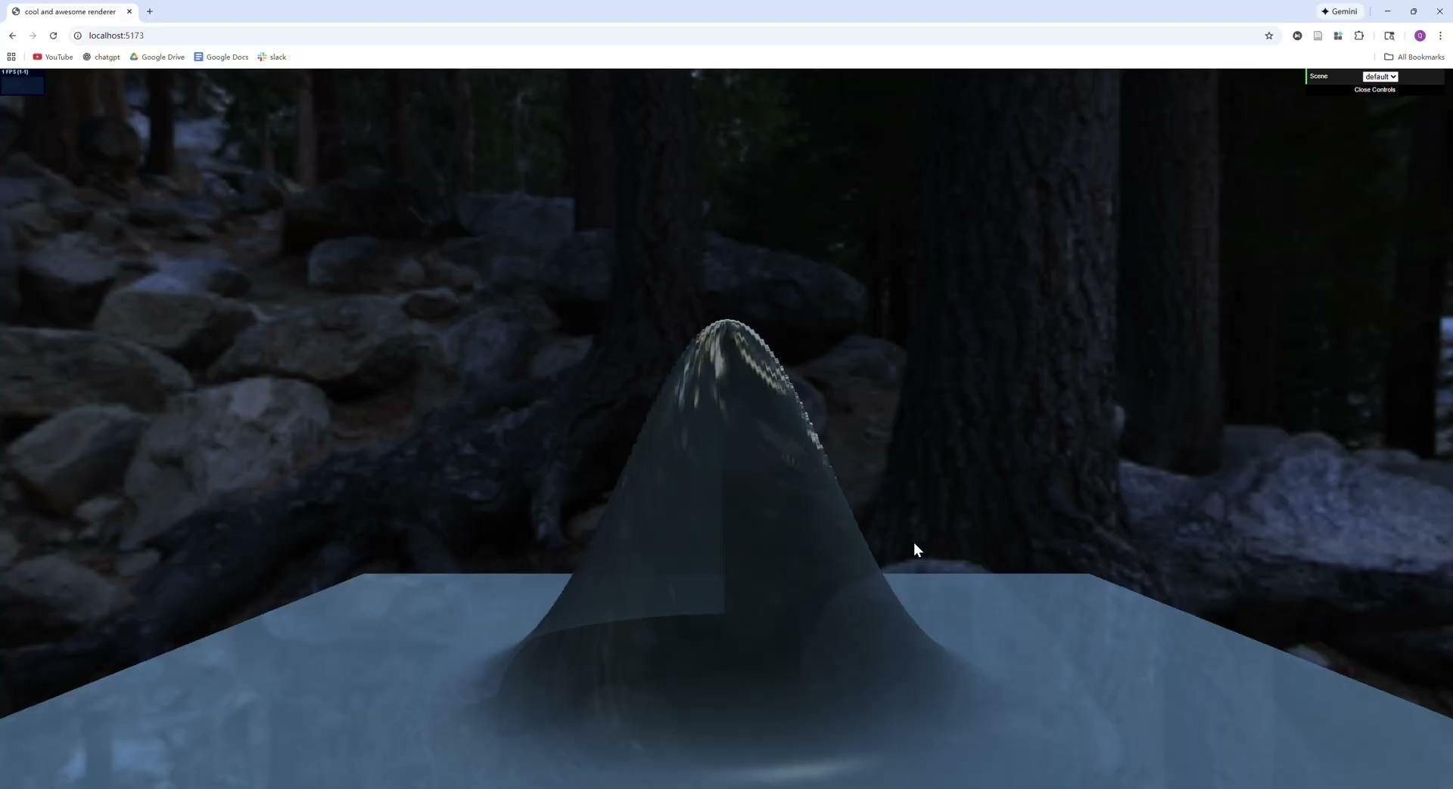
Work for future milestones

